Slide 1
OSLC Enhancements for PLM
Krishnan Srinivasan
Sai Ganesh Ramani
Ed Gentry
Siemens Digital Industries Software
Date: 2024-10-03

Slide 2
Scope of the Specification
Extend the OSCL domains specifications to introduce new domains to include PLM domains like
Bill of Material of Parts
Mechanical Design Data
Electrical and Electronics Data
Support OSLC Providers and Consumers for the new domains
Extend the existing specifications to link to artifacts from PLM Domains to artifacts in existing domains like Architecture and requirements
© Siemens 2024| Siemens Digital Industries Software | Where today meets tomorrow.
ns Digital Industries Software | Where today meets tomorrow.

Slide 3
Use case 1 – Part/Design (PLM Domain) satisfies Requirement (RM)
Link Requirements in an ALM tools to Part Bill of Material or Design Bill of Material in a PLM tool
The link could be to a Usage of Part in a Configured structure or to a Part itself
Part/Design satisfies a Requirement
User navigates the link between Requirement and Part/Design BOM
PLM Tool
ALM Domain
Part or Design BOM
Requirement (RM Domain)
© Siemens 2024| Siemens Digital Industries Software | Where today meets tomorrow.
ns Digital Industries Software | Where today meets tomorrow.

Slide 4
Use case 2 – Part/Design (PLM Domain) Realizes Architecture Resource (AM)
Link Architecture Resource in an ALM tools to Part Bill of Material or Design Bill of Material in a PLM tool
The link could be to a Usage of Part in a Configured structure or to a Part itself
Part/Design Realizes an Architecture Resource
User navigates the link between Architecture Resource and Part/Design BOM
PLM Tool
ALM Domain
Part or Design BOM
Architecture Resource (AM Domain)
© Siemens 2024| Siemens Digital Industries Software | Where today meets tomorrow.
ns Digital Industries Software | Where today meets tomorrow.

Slide 5
Use case 3 – Test Case(QM) verifies Part/Design (PLM Domain)
Link Test Case in an ALM tools to Part Bill of Material or Design Bill of Material in a PLM tool
The link could be to a Usage of Part in a Configured structure or to a Part itself
Test case Verifies a Part/Design
User navigates the link between Test Case and Part/Design BOM
ALM Domain
PLM Tool
Test Case (QM Domain)
Part or Design BOM
© Siemens 2024| Siemens Digital Industries Software | Where today meets tomorrow.
ns Digital Industries Software | Where today meets tomorrow.

Slide 6
Use case 4 – Submit and Resolve Change on Part/Design
User A submits a problem with Part/Design in a PLM tool. User A identifies other related objects (such as Requirements and Test Cases) in ALM tool
User B works on the problem, identifies the solution and other affected objects makes necessary changes to Part/Design
User A is notified of the resolution and affected objects. User A navigates the relevant information
© Siemens 2024| Siemens Digital Industries Software | Where today meets tomorrow.
ns Digital Industries Software | Where today meets tomorrow.

Slide 7
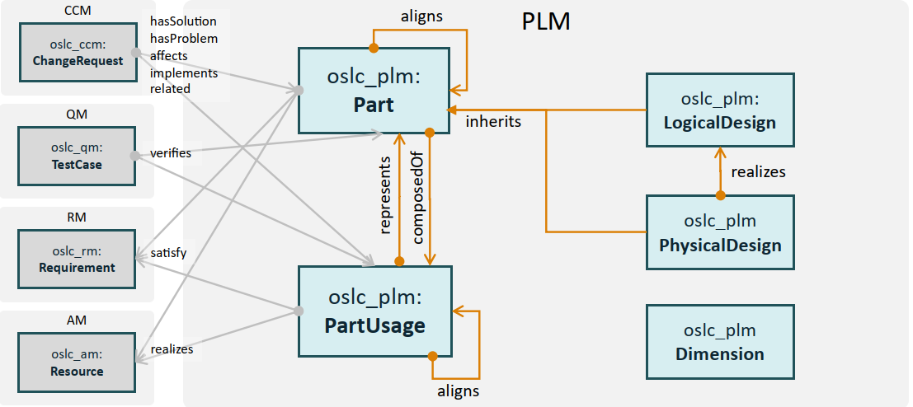
New PLM Domain Model
© Siemens 2024| Siemens Digital Industries Software | Where today meets tomorrow.
ns Digital Industries Software | Where today meets tomorrow.

